Slide 1
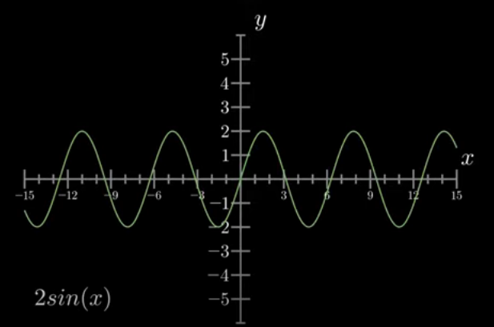
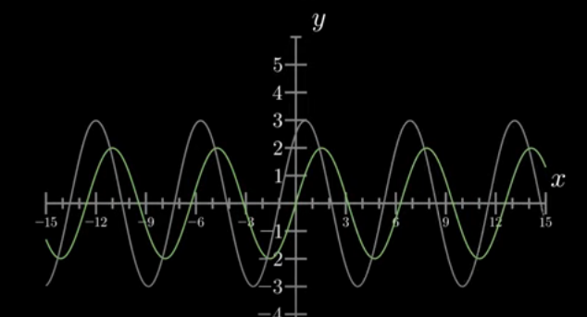
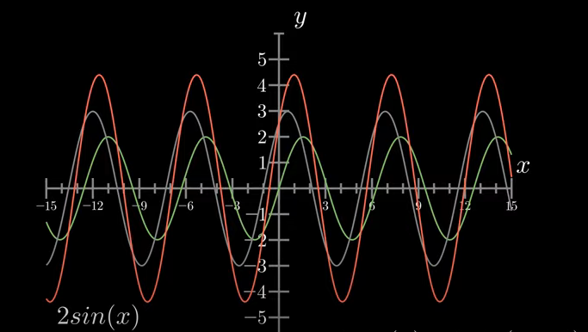

Slide 2
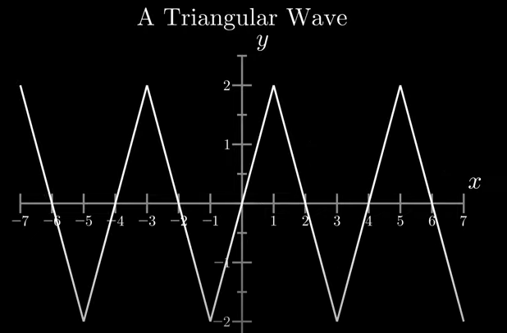
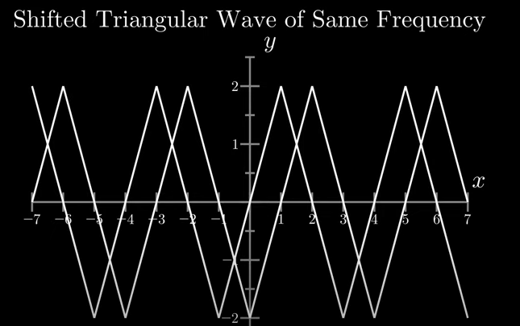
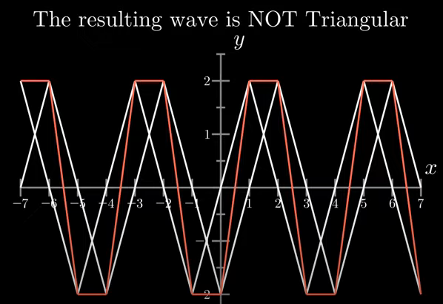

Slide 3
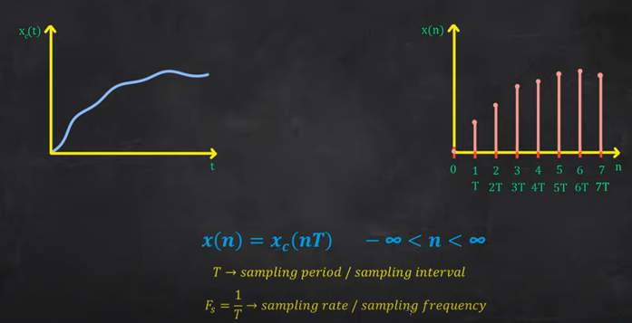
Normalized frequency
t=nT=n/Fs

Slide 4
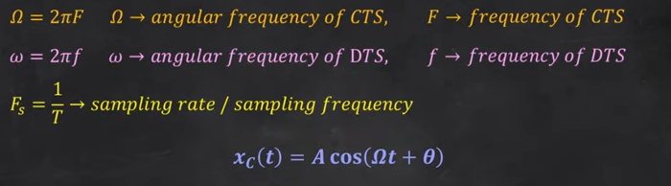
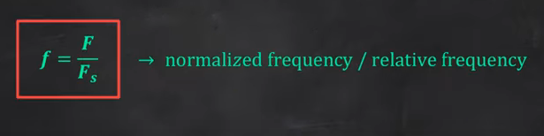

Slide 5
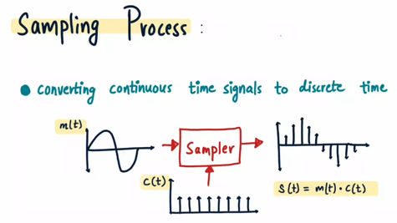

Slide 6
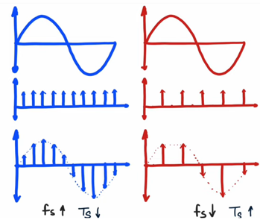

Slide 7
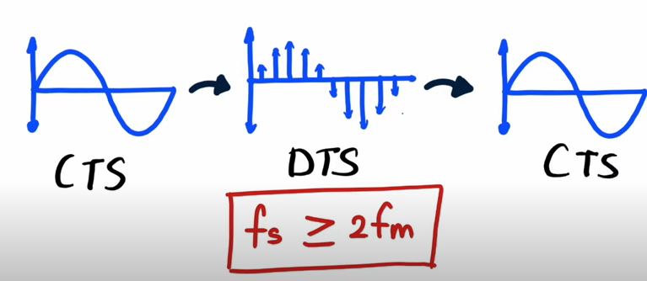

Slide 8
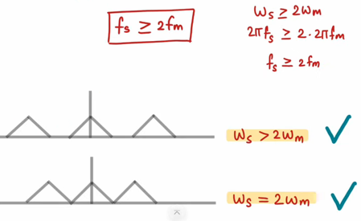

Slide 9
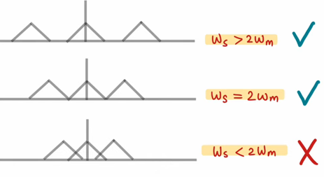

Slide 10



Slide 11
Consider an analog signal
x(t) = 2 cos (100Πt)
a) Determine the minimum sampling rate to avoid aliasing
b) Suppose sampling rate is 200Hz. Write the equation of discrete time signal after sampling.
c) Suppose the signal is sampled at 75Hz. What is the discrete time signal obtained after sampling.

Slide 12
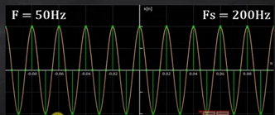
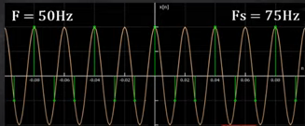
x(t) = 2 cos (100Πt)
x(t)=2cos (2Π50t)
x(t)=2cos (2Π50nT)
x(t)=2cos (2Πn50/Fs)
x(t)=2cos (2Πn50/200) = 2cos (Πn/2)

Slide 13
Consider an analog signal
a) x(t) = 2 cos (20Πt)+ 3 sin (300Πt) – cos (100Πt)
Determine the minimum sampling rate to avoid aliasing
b) x(t) = 2 sin (2Π100t)
Determine the minimum sampling rate to avoid aliasing

Slide 14
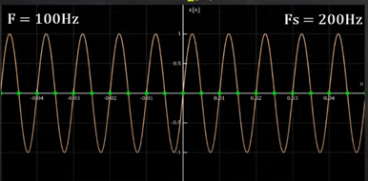
x(n) = 2 sin (2Π100 n/200)
x(n) = 2 sin (Πn)

Slide 15

Problems/ Confusions in Sampling

Slide 16
Filters ???
Male and Female voice signals ??
We approximate systems and for that we need linearity and shift invariance.

Slide 17


